Slide 1


UNIVERSITY INSTITUTE OF ENGINEERING
Academic Unit V
Bachelor of Engineering (Computer Science & Engineering)
Biology For Engineers
22SZT-148
DISCOVER . LEARN . EMPOWER
BIOLOGY FOR ENGINEERS

Slide 2
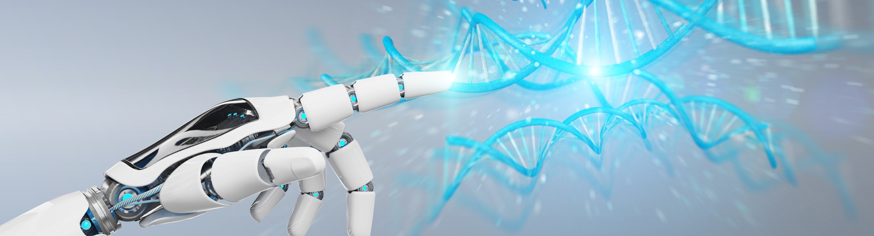
INTRODUCTION
Course Objective
This subject is designed to impart fundamental knowledge on basic of genetics and emerging fields of biology like biomedical recording system and medical instrumentation.
It is designed to impart knowledge that how to apply basics of biology in engineering.
https://www.uic.es/sites/default/files/uic-grau-bioenginyeria-hero-header_1.jpg
Biology for Engineers

Slide 3


INTRODUCTION
Space for visual (size 24)
Course Outcome
CO Number | Title | Level
CO1 | Identify the biological concepts from an engineering perspective. | knowledge
CO2 | Development of artificial systems mimicking human action. | Understand
CO3 | Explain the basic of genetics that helps to identify and formulate problems | Analyze
CO4 | Apply knowledge of measurement system, biomedical recording system and biosensors to excel in areas such as entrepreneurship, medicine, government, and education. | Apply
CO5 | Integrate biological principles for developing next generation technologies, | Create
Will be covered in this lecture
https://specials-images.forbesimg.com/imageserve/1034901762/960x0.jpg?fit=scale
BIOLOGY FOR ENGINEERS

Slide 4
SYLLABUS
Unit-1 | Importance of Biology In Engineering | Contact Hours: 15
Chapter 1 Significance of Biology in Engineering Chapter 2 Genetics | Introduction: Fundamental Differences between Science and engineering by drawing a comparison between eye and camera, Bird flying and aircraft. Significance of Biology in Engineering, Discuss how biological observations of 18th Century that lead to major discoveries, Examples from Brownian motion and the origin of thermodynamics by referring to the original observation of Robert and Julius Mayor. Genetics: Mendel’s laws, Concept of segregation and independent assortment, concept of allele, gene mapping, Gene interaction, Epitasis, Meiosis and Mitosis as a part of genetics. Mechanism of how genetic material passes from parent to offspring. Concepts of recessiveness and dominance. Concept of mapping of phenotype to Genes, single gene disorders in humans, concept of complementation using human genetics.
BIOLOGY FOR ENGINEERS

Slide 5
SIGNIFICANCE OF BIOLOGY IN ENGINEERING
BIOLOGY FOR ENGINEERS

Slide 6
WHY DOES AN ENGINEER NEED ANY KNOWLEDGE OF BIOLOGY?
Due to the nature of engineering, problem solving requires the most background knowledge as you can get.
The more knowledge you have about natural structures and functions the easier it will be to create artificial ones.
By adapting mechanisms and capabilities from nature, scientific approaches have helped humans understand the related phenomena and the associated principles in order to engineer novel devices and improve their capability
Since this is the century of biology, a similar phenomenon is expected, which will lead to probably another revolution. Many engineers are expected to contribute to a biological aspect to fuel this revolution.
BIOLOGY FOR ENGINEERS

Slide 7
NEED FOR BIOLOGY
It is very much important for engineering students to understand the basic principles and introduction of biological concepts so that they can effectively interact to concern for providing solutions to the problems related to biosystems.
Therefore, the undergraduates of engineering need to be suitably exposed at least to the very minimum biology, so that they would at least be able to consider a biological system/aspect in which they could later make appropriate contributions, through their main expertise, say electrical engineering, mechanical engineering, computer science, materials engineering, or any other.
BIOLOGY FOR ENGINEERS

Slide 8
BIOLOGY FOR ENGINEERS
Principles of biology + tools of engineering
>>>>>
Create usable and economically valuable products.
Biological engineering, or bioengineering/bio-engineering, is the application of principles of biology and the tools of engineering to create usable, tangible, economically valuable products.
In general, biological engineers (or biomedical engineers) attempt to either mimic biological systems to create products or modify and control biological systems so that they can develop novel instruments, devices etc.
BIOLOGY FOR ENGINEERS

Slide 9
BIOMIMICRY OR BIO-INSPIRED DESIGN
Biomimicry involves the translation of knowledge obtained from the natural world into new innovations.
When using nature as inspiration we learn from a system that has developed resilience, adaptability and efficiency over centuries.
This is also called bio-inspired design.
Lessons from nature can be translated into innovations in the fields of products, organizational forms and processes.
BIOLOGY FOR ENGINEERS

Slide 10
BIOMIMICRY OR BIOMIMETICS
Some of the commercial implementations of the progress in biomimetics can be seen in toy stores, in which toys appear and behave like living creatures (e.g., dogs, cats, birds, and frogs).
More serious benefits of biomimetics include the development of system very much like biological origin, and sensory aiding mechanisms that are interfaced to the brain to assist in hearing or seeing or controlling instruments.
BIOLOGY FOR ENGINEERS

Slide 11
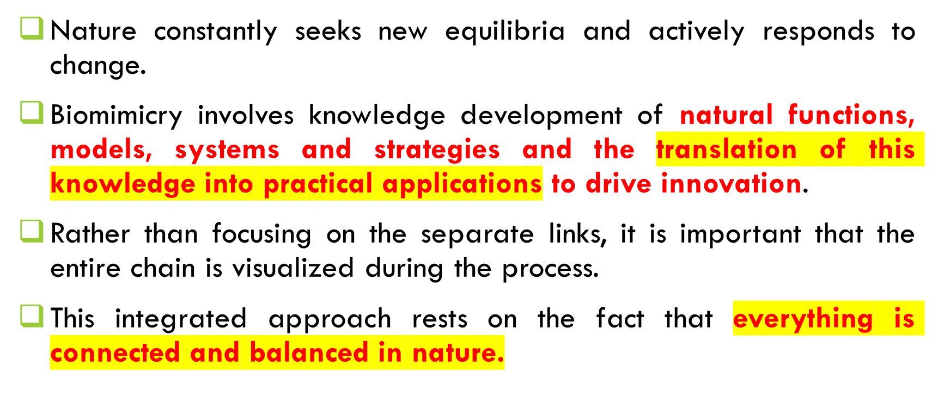
BIOMIMICRY
BIOLOGY FOR ENGINEERS

Slide 12
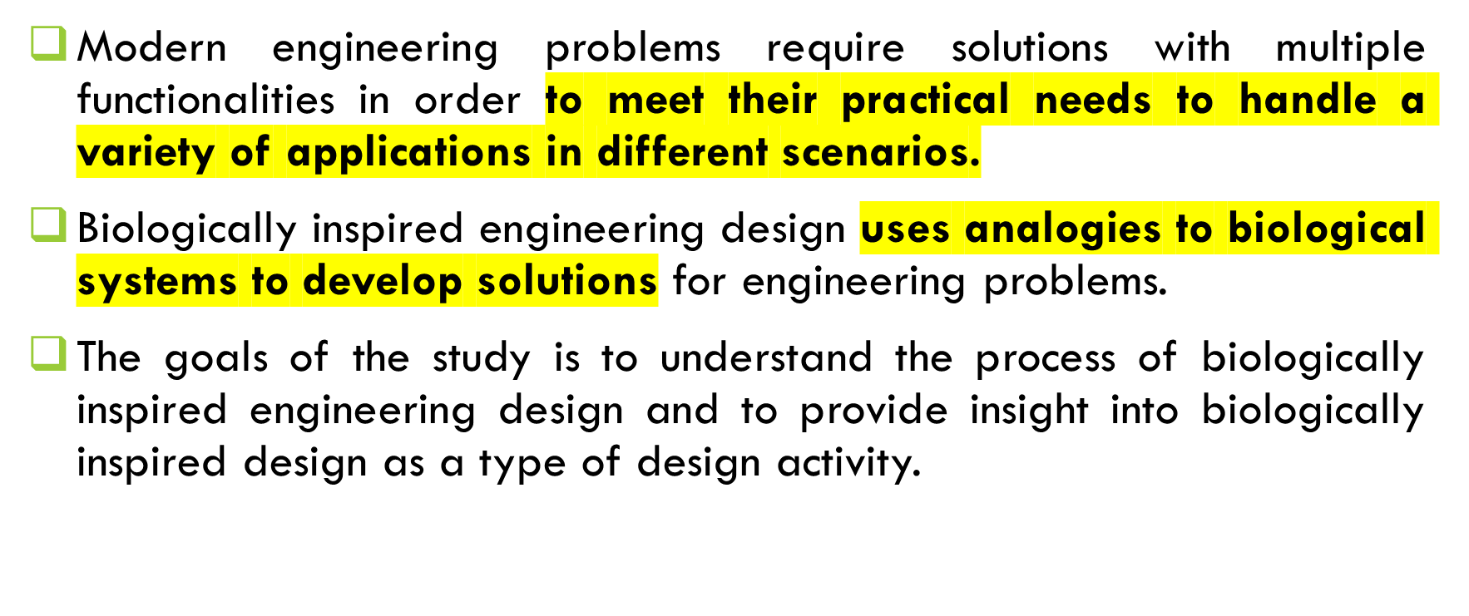
BIOLOGICALLY INSPIRED DESIGN (BID)
BIOLOGY FOR ENGINEERS

Slide 13
BIOMIMETIC DESIGN:
EXAMPLES OF NATURE INSPIRING TECHNOLOGY
BIOLOGY FOR ENGINEERS

Slide 14
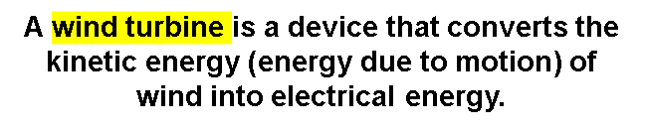
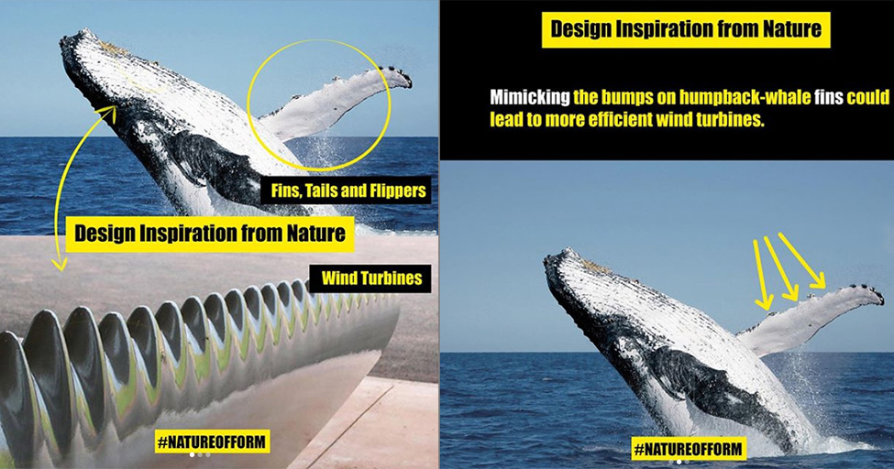
WHALE :: WIND TURBINES
The humpback (abnormal curvature) of whale weighs an astonishing 36 tonnes, yet it is one of the most elegant swimmers, divers and jumpers in the sea.
As first researched by Frank Fish, a biomechanic, these aerodynamic abilities are greatly attributed to the bumpy protrusions on the front of its fins, called tubercles.
Whales use their fins at different angles to increase their lift.
By comparing bumpy blades to smooth-edged ones, scientists found that stalling occurs at a much higher angle with tubercles – an increase by nearly 40 per cent.
Further testing also revealed that serrated-edge wind turbines proved to be more efficient and quieter than the typical smooth blades.
Tubercles
The bump-like tubercles on a humpback whale
Tubercles (Humpback with irregular curvatures) >>>>>>>> Responsible for adding extra efficiency
Improve fluid flow over the flipper's surface

Slide 15
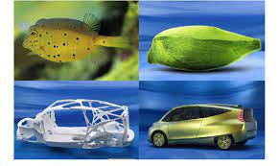
BOX FISH AND THE BIONIC CAR
Despite the cumbersome appearance of the boxfish, it has a low flow resistance and a drag coefficient of an astounding 0.06. In comparison, penguins swimming through water have a coefficient of 0.19.
In 2005, inspired by the great structural strength and low mass of the boxfish, Mercedes Benz developed the Bionic Car, which reported to reduce drag, have great rigidity, low weight and a significantly lower fuel consumption than traditional cars.
https://youtu.be/5tFqlhATUZs
BIOLOGY FOR ENGINEERS

Slide 16
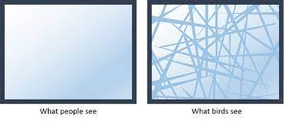
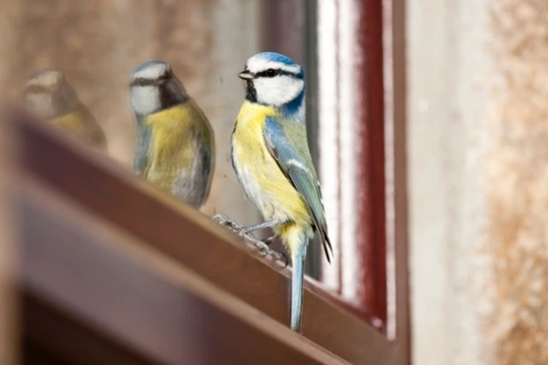
BIRD-SAFE GLASS
It is estimated that 100 million birds die every year as a result of flying into glass, and the reason is obvious – they simply do not recognise the transparent structure as a physical barrier.
To address this problem, a company developed biomimetic Ornilux Birdsafe Glass, drawing inspiration from the UV reflective strands in spider webs, which birds see and therefore avoid.
This is a clear mutual benefit for both species, and so Ornilux sought to replicate this with their criss-crossing UV glass.
BIOLOGY FOR ENGINEERS

Slide 17
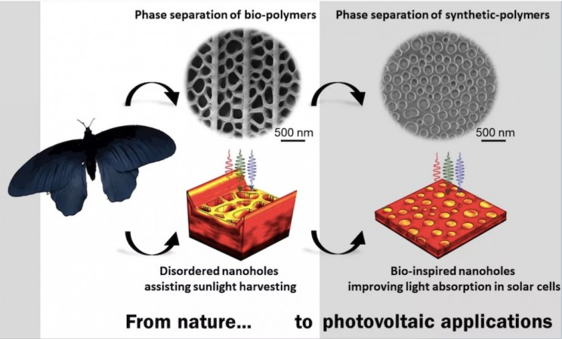
BUTTERFLY AND SOLAR CELL
The rose butterfly has tiny cells on its intricate and delicate wings that can collect light at any angle.
The black wings of the rose butterfly have inspired a new type of solar cell that is two times more efficient at harvesting light
BIOLOGY FOR ENGINEERS

Slide 18
OTHER EXAMPLES:
1. Aircraft wing design and flight techniques are being inspired by birds and bats.
2. Biorobots based on the physiology and methods of locomotion of animals include BionicKangaroo which moves like a kangaroo, saving energy from one jump and transferring it to its next jump.
3. Techniques used in camera are inspired by human eye.
4. Suction nozzle of vacuum cleaner is inspired by proboscis of flies (elongated sucking mouthpart).
BIOLOGY FOR ENGINEERS

Slide 19
USE OF ENGINEERING IN BIOLOGY
Mechanical Engineering: Biological system prosthetics.
Computer science and engineering: Computational biology robotics.
Electrical engineering: Robotics devices and photonics signals & image processing.
Chemical engineering: Biotechnological nanoparticles interfaces polymers biofuels.
BIOLOGY FOR ENGINEERS

Slide 20
CONCLUSION
Biomimicry has the best potential to be harmonious with nature while resulting in better outcomes than any artificial means of development.
Animals, plants, and insects have utilized such technology to establish their ecosystem with no adverse effects to nature, and such behavior and way of life is what we humans may need in the current era.
BIOLOGY FOR ENGINEERS

Slide 21
TOPIC FOR SELF STUDY
Biological Observations of 18th century that lead to major discoveries
BIOLOGY FOR ENGINEERS

Slide 22
REFERENCES
Biologically Inspired Design; Computational Methods and Tools Ashok K Goel, Daniel A McAdams, Robert B. Stone (Ed). Springer, 2014.
https://doi.org/10.1007/978-1-4471-5248-4
https://youtu.be/tont-BzM1II
https://doi.org/10.3389/fnbot.2019.00078
https://www.researchgate.net/publication/242526086
Gupta, P.K.. Cytology, Genetics and Molecular Biology, Rastogi Publishers, Meerut, 1993.
Roit I.M., Brostoff J. and Male D. Mosby .Immunology (6 th Edition) by, An imprint of Elsevier Sci Ltd., 2002.
https://nptel.ac.in/courses/121/106/121106008/
https://www.utoledo.edu/engineering/bioengineering/undergrad/prospective/whatisbioe.html#:~:text=Bioengineering%20is%20the%20application%20of,health%20care%20and%20other%20fields.
https://i.pinimg.com/originals/68/c9/30/68c930e95113ceb2e3dfc9de2f164680.png
https://youtu.be/FBUpnG1G4yQ
BIOLOGY FOR ENGINEERS
30

Slide 23

THANK YOU
BIOLOGY FOR ENGINEERS

